Slide 1
Concession Stand Rehab
HP 303
Amanda English

Slide 2
Project Description
I have been volunteering for the Sauquoit Valley Youth Association for about 7 years now. The past two years I have been the concession coordinator for the program. I do all of the planning, purchasing, scheduling and selling for the concession stand. I grew up in this program as a softball player, and the daughter of two very dedicated parents. They also volunteered for years in this program. S.V.Y.A helps kids become ball players and provides them with confidence.
The concession stand is a vital part of the S.V.Y.A organization. It is the biggest money maker for the association. The cupboards that are in the concession stand now have been there since the building was built. Minor improvements have been made over the years to keep up with the demand, however, it is time to give it a facelift. The concession stand suffered damage from a pipe burst in December. There is a clause in the insurance policy that says if the building is not heated, they do not pay. So of course, they will not be making a payout. The concession stand needs this make-over now more than ever.

Slide 3
Who Will Benefit
First and foremost, the kids will benefit from the rehabilitation of the concession stand. Enhancing the visuals of the interior will increase curiosity, bringing more customers. The ability to handle more volume guarantees more funds being brought in which can be put towards field maintenance and new uniforms and equipment.
In addition to the kids benefiting, their parents do also. The more money that we make in the concession stand ensures that the registration fee can stay low.

Slide 4
The Planning Details

Slide 5
Present Condition
Cabinets are very old and water damaged. They also do not stay closed.
The drawers do not have tracks that keep them level when they are pushed in.
Sink is not deep enough to wash dishes.
Toilet tanks are cracked from pipe burst.
Paint needs to be updated, colorful in concession stand and bathrooms.
Space is not being used as well as it could be,

Slide 6
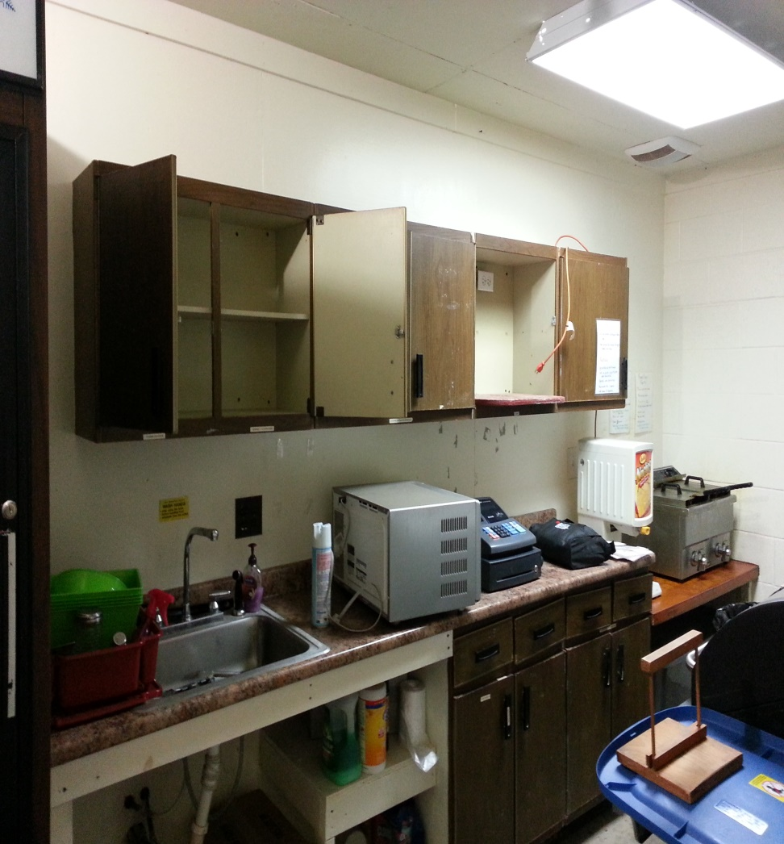
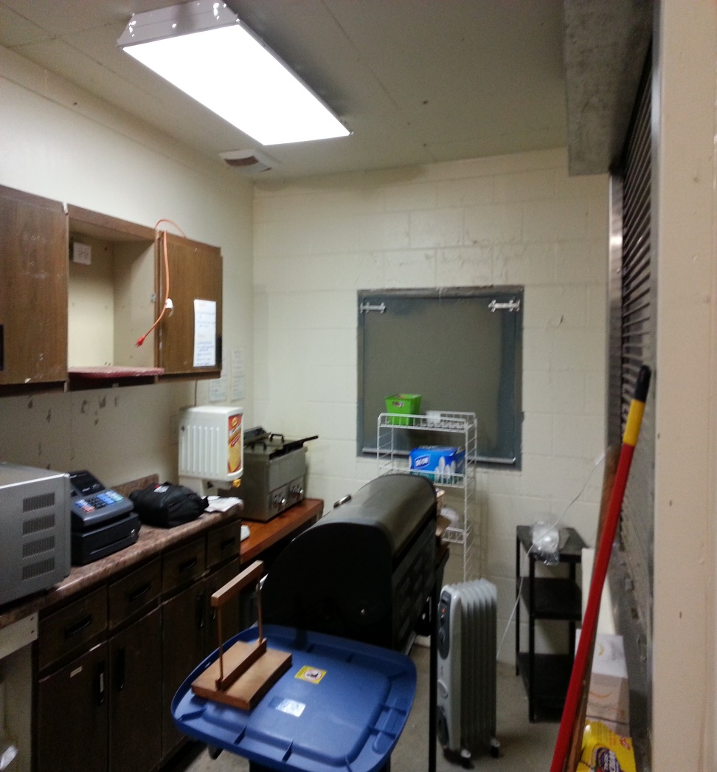
Before Clean-up and Demo

Slide 7
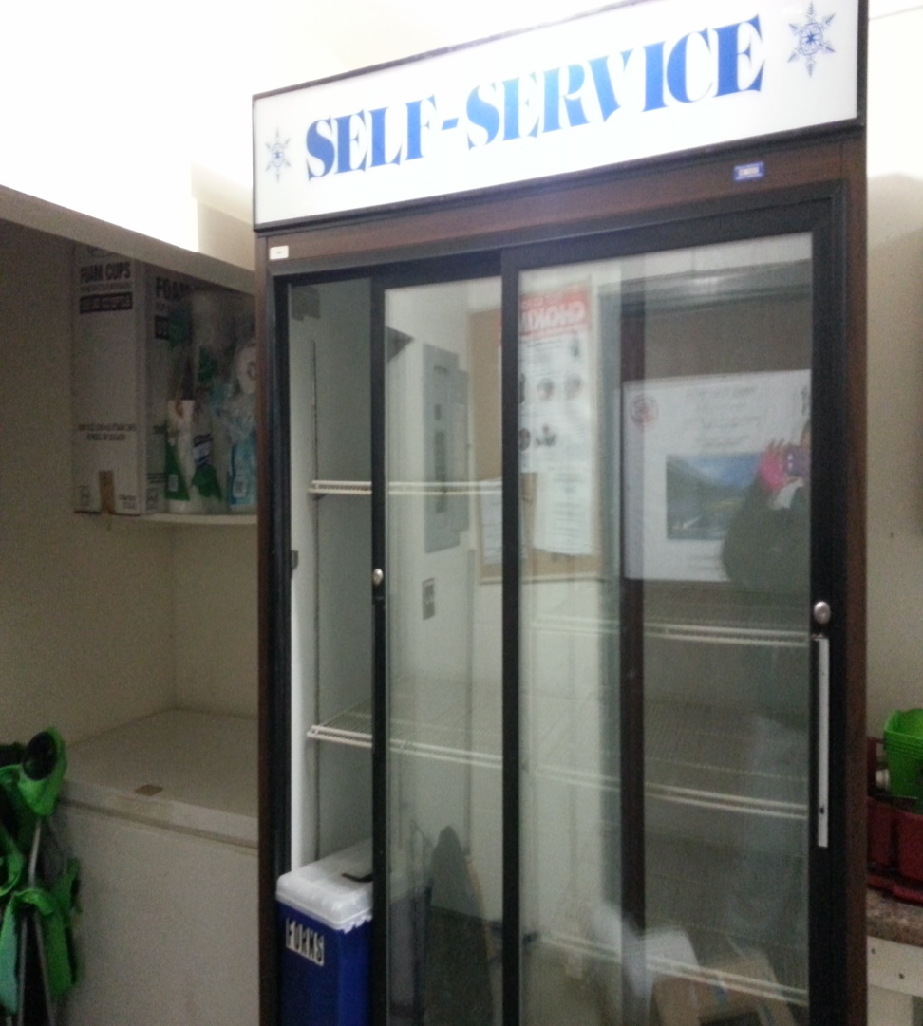
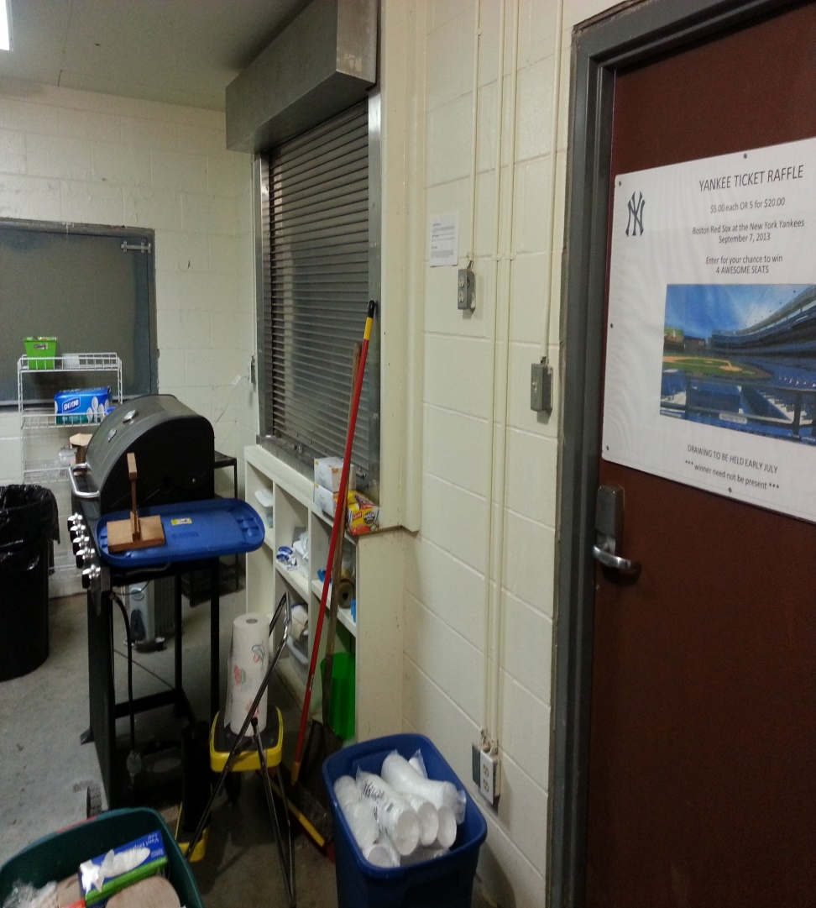
Cleaning up and moving stuff

Slide 8
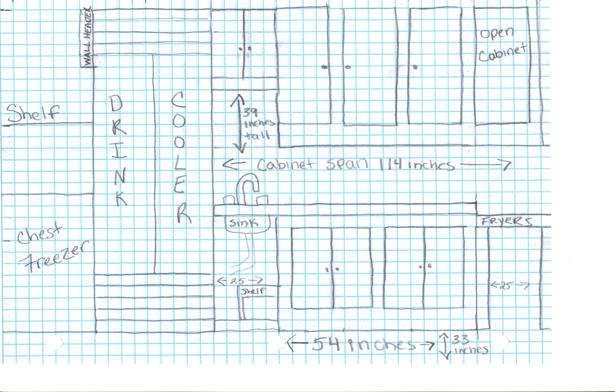
Floor Plan #1

Slide 9
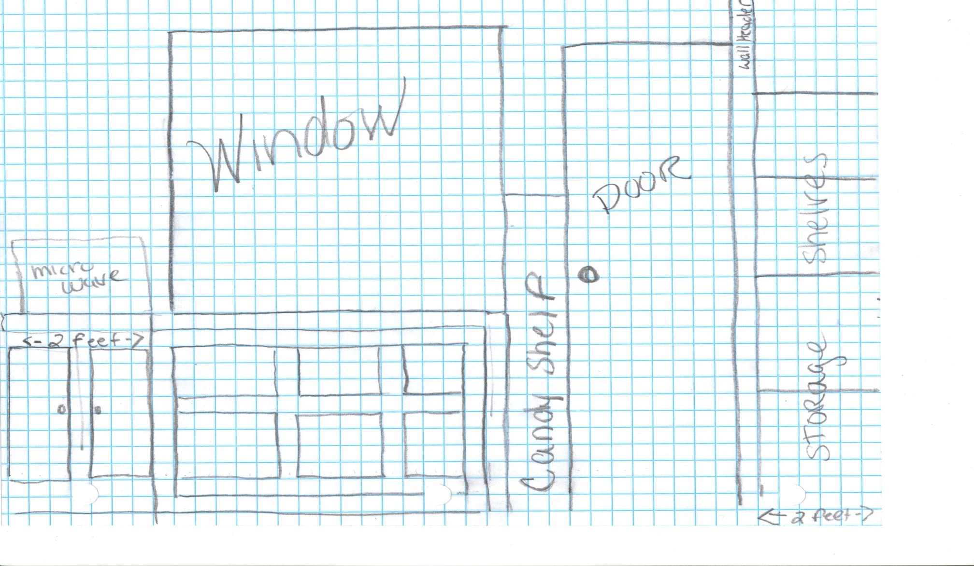
Floor Plan #2

Slide 10
Materials
Item | Description | Quantity | Unit Cost | Total Cost | Source
Red Paint | Int./ Ext. Glidden | 2 Gallons | $21.97 | $43.94 | Home Depot
Navy Blue Paint | Int./ Ext. Glidden | 1 Quart | $9.88 | $9.88 | Home Depot
Orange Paint | Int./ Ext. Glidden | 1 Quart | $9.88 | $9.88 | Home Depot
White Paint | Int./ Ext. Glidden | 1 Quart | $9.88 | $9.88 | Home Depot
Black Paint | Int./ Ext. Glidden | 1 Quart | $9.88 | $9.88 | Home Depot
Royal Blue Paint | Int./ Ext. Glidden | 1 Quart | $9.88 | $9.88 | Home Depot
Kitchen Sink | Drop in Basin Sink | 1 | $99.00 | $99.00 | Home Depot
Cabinets and countertop | Base & Wall; small countertop | 8 | $0.00 | $0.00 | Kevin Fahy Kitchens

Slide 11
Supplies
Supply | Price | Source
Roll Off Dumpster | Donated | Marshall Pryzluke
Paint Brushes | $9.97 | Home Depot
Paint Rollers | $9.78 | Home Depot
Paint Trays | $4.97 | Home Depot
Sandpaper | Donated | Amanda
Screws | $5.58 each - $12.14 | Lowe’s
Caulk | $5.28 | Home Depot
2x2x8 board | $1.52 | Home Depot
Shovel | Borrowed | Kevin Williams

Slide 12
Tools
Tools | Quantity | Source
Drills | 2 | Kevin Williams and Jamie Clarey
Screwdriver | 1 | Kevin Williams
Tape Measure | 2 | Kevin Williams and Jamie Clarey
Paint Roller Handles | 4 | Amanda English
Circular Saw | 1 | Jamie Clarey
Level | 1 | Home Depot $15.98
Snow Plow | 1 | Wayne Inglis
Truck | 1 | Kevin Sloma
Extension Cord | 2 | Kevin Williams and Jamie Clarey
Heaters | 2 | Amanda English
Camera and Music | 1 | Amanda English

Slide 13
Preliminary Schedule
Week 1 | Week 2 | Week 3 | Week 4 | Week 5 | Week 6
Send in project request | Contact Kevin Fahy | Clean out building | Painting | Painting | Install cabinets
Start work on drafting project | Take measure-ments of cabinets | Demolition of cabinets |  |  | Install countertops
Contact Kevin Fahy Kitchens | Pick out cabinets |  |  |  | Work on Final project
See Insurance Adjuster | Pick up cabinets
Get dumpster delivered | Work on drafting project

Slide 14
Detailed Schedule
January 13 – Call Kevin Fahy kitchens to ask for a cabinet donation – Missy Clarey
January 14 – Call Marshall Pryzluke to ask for a roll off dumpster – Kevin Sloma
January 14 – Get measurements for allowable cabinet space – Amanda English
January 15 – Roll off dumpster delivered to field.
January 17 – 4:00 appointment with Kevin Fahy at Fahy Kitchens – Missy Clarey and Amanda English

Slide 15
Detailed Schedule cont.
January 18 – 1:00 p.m. Amanda arrives at field
Take pictures of before view
Remove trash, fryer oil, fryers, cheese machine. Clean out freezer
Clean out cabinets: box up supplies, throw away anything unsalvageable.
Clean off countertop – Coffee pot, cash register
Wipe down all countertops, appliances, coolers
End time 4:00p.m.

Slide 16
Detailed Schedule cont.
January 20 – Amanda arrives at field 1:00 p.m. with Kevin Williams
Remove wall cabinets
Remove sink
Remove countertop and SAVE
Remove bottom cabinets – End 3:00 p.m.
4:00 p.m. – arrive at Kevin Fahy Kitchens- Amanda English, Missy Clarey, Kevin Williams and Kevin Sloma
Load cabinets into back of Kevin Sloma’s truck
Arrive at field and unload – End 5:30 p.m.

Slide 17
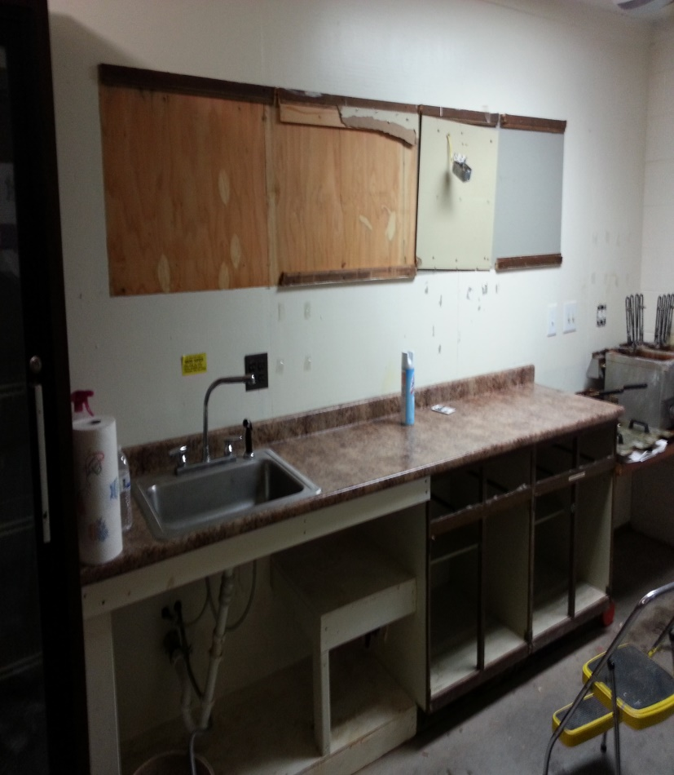
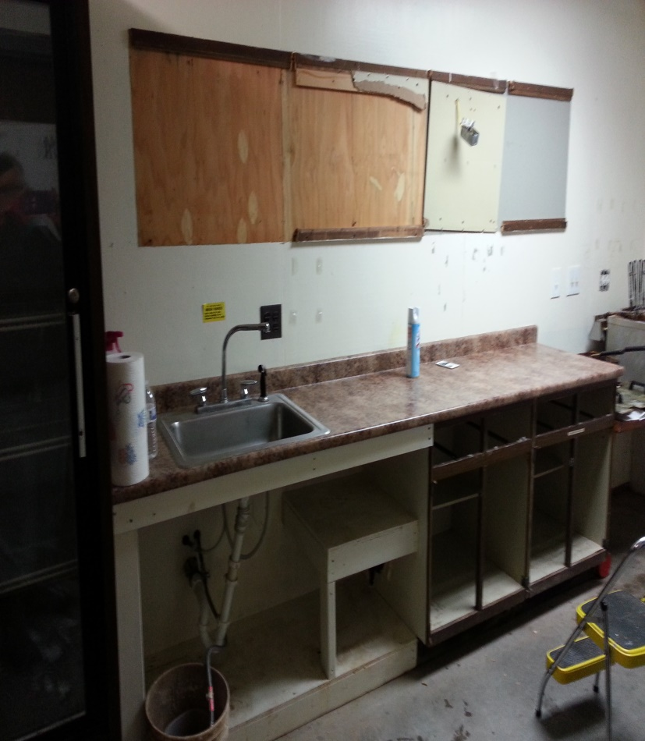
DEMOLITION!!!!!!
Available space for upper cabinets is 9.5 feet across, and no more than 40 inches tall to leave room for counter space and not hang over the fryers
Lower cabinets should be 54 inches across and 33 inches tall to fit between fryer counter and sink base

Slide 18
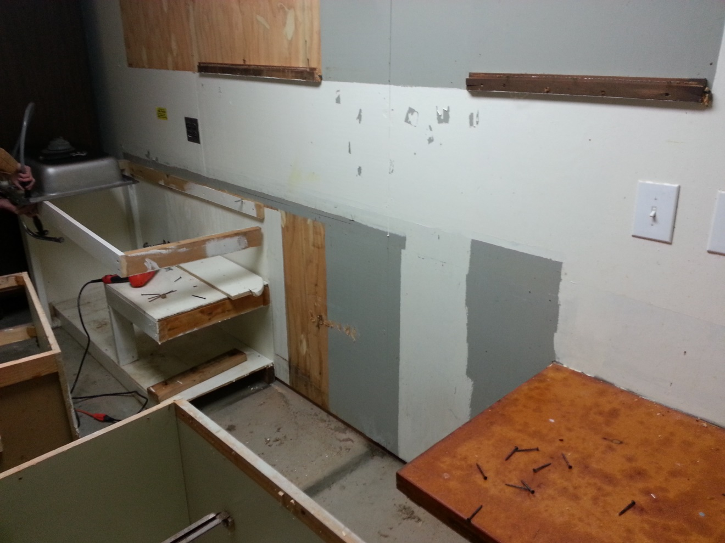
Finally all the cabinets are out!!!!
Cleaning up and demolition was completed by myself and Kevin Williams. I ripped out the upper cabinets myself, but delegated the bottom cabinets to him so that the countertop could be saved.

Slide 19
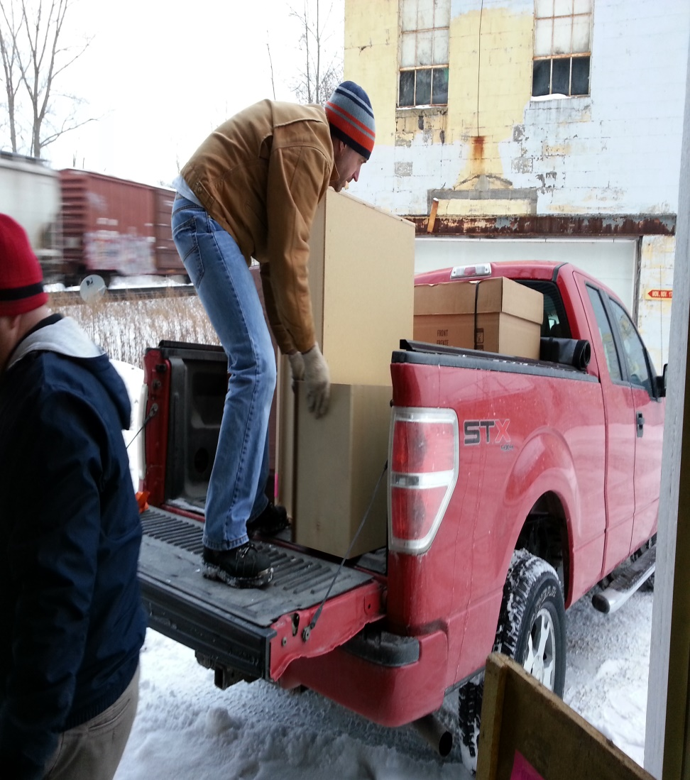
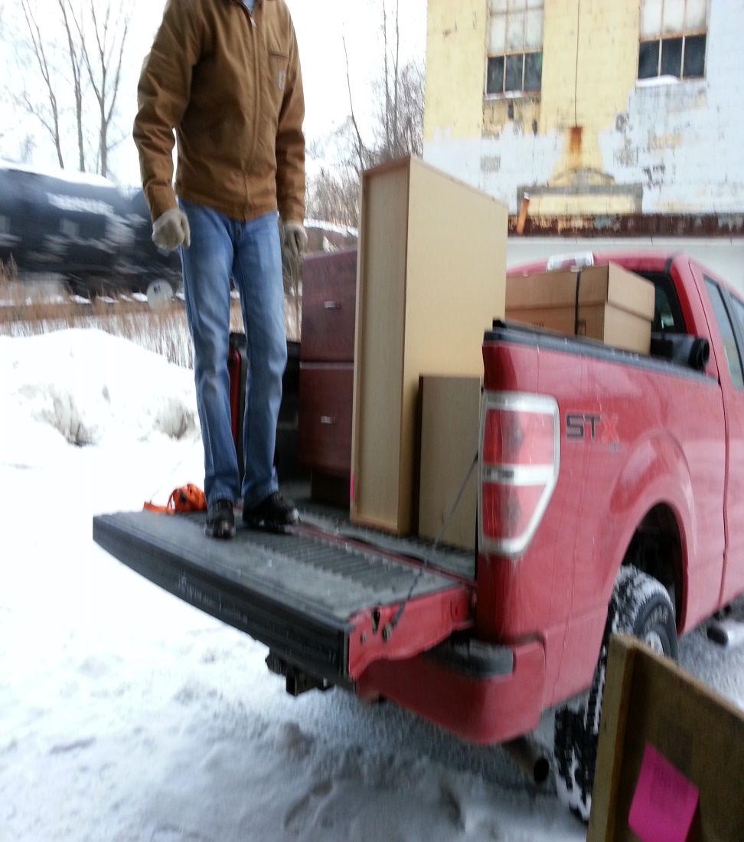
Picking up new cabinets! THANK YOU KEVIN FAHY KITCHENS!!!!!

Slide 20
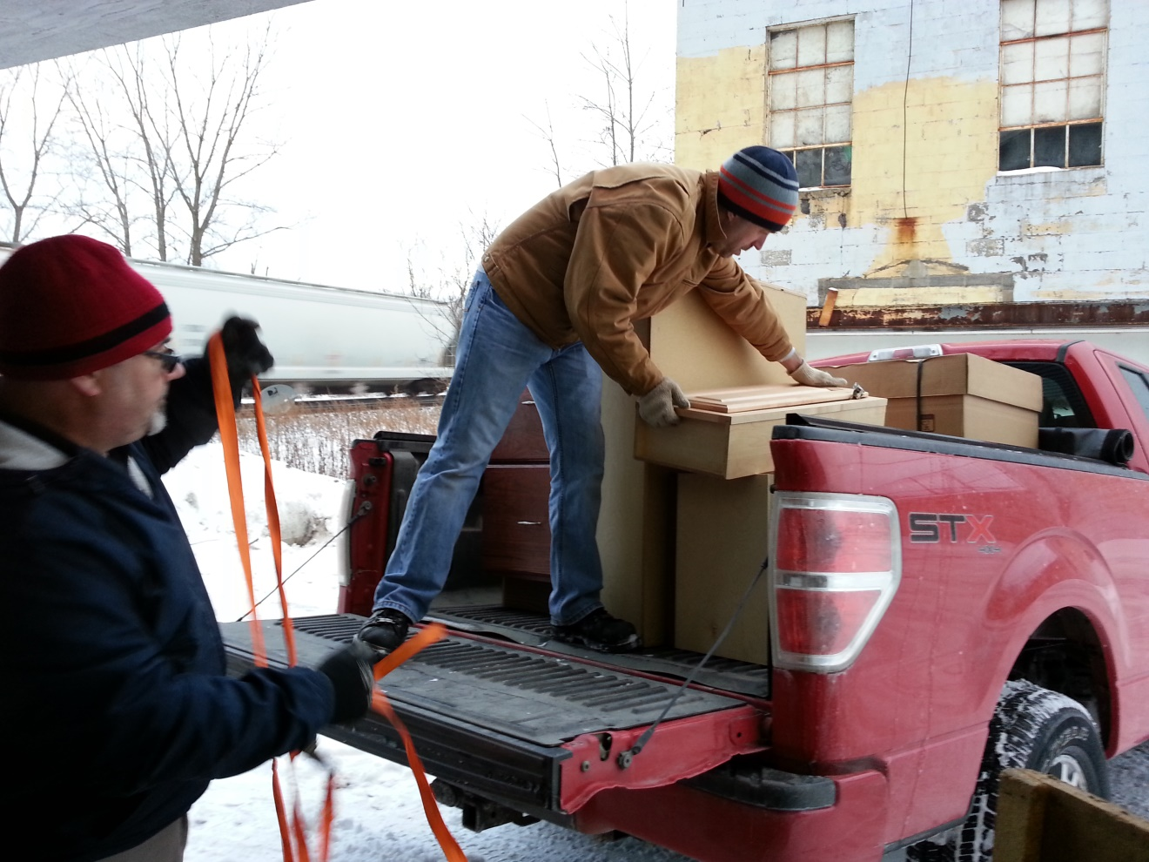
All loaded up! Time to tie them down!
All cabinets were donated by Kevin Fahy Kitchens on Commercial Drive in New York Mills. Cabinets were picked out by myself and Missy Clarey, and picked up by Kevin Williams and Kevin Sloma.

Slide 21
Detailed Schedule cont.
January 31 – 4:30 p.m. Amanda English and Kevin Williams arrive at Home Depot.
Pick out paint and get it mixed
Paintbrushes, rollers, paint trays – End 5:30 p.m.
February 1 – 1:00 p.m. Amanda English, Missy Clarey, Emilee Clarey and Kellie Sloma arrive at field to paint interior of concession stand. End 4:00 p.m.

Slide 22
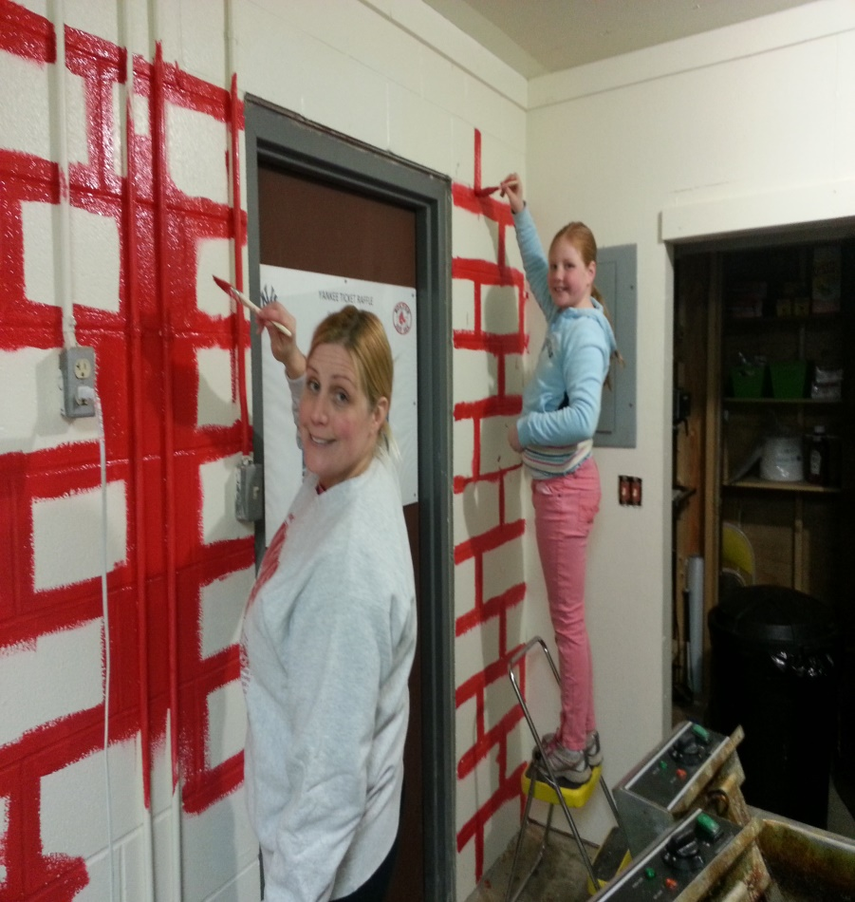
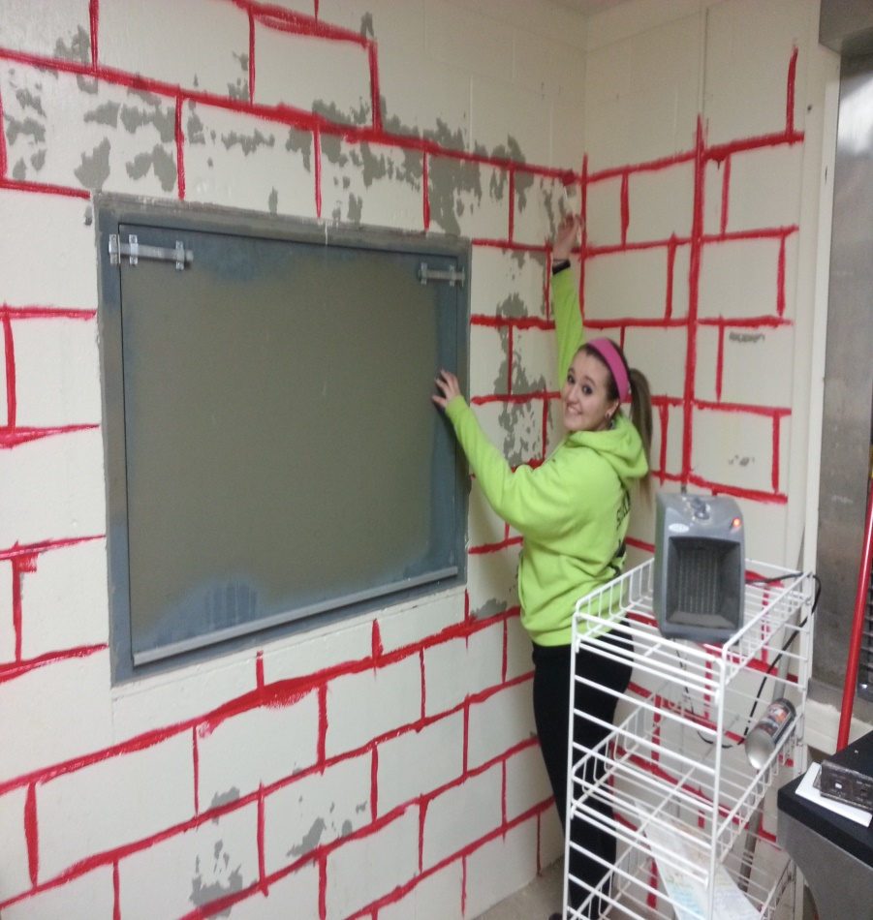
Getting our paint on!
My mistake with the paint, we should have primed all walls due to chipped paint causing grey color to show through. Water damage caused the paint to bubble and crack in spots
Filling the creases of the cement blocks making it easier to roll

Slide 23
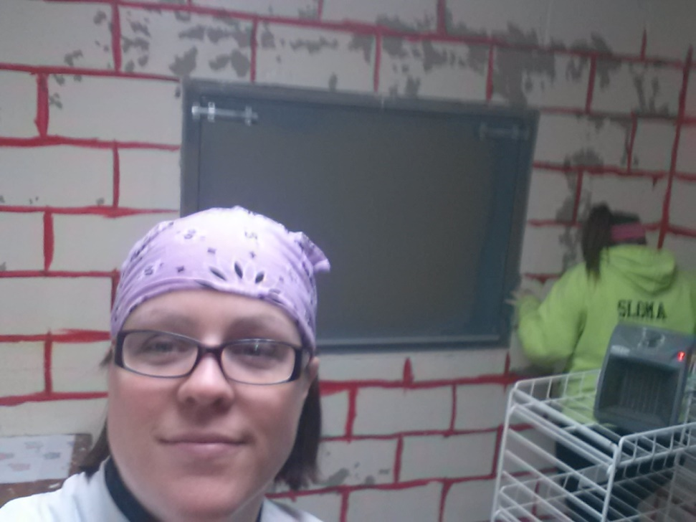
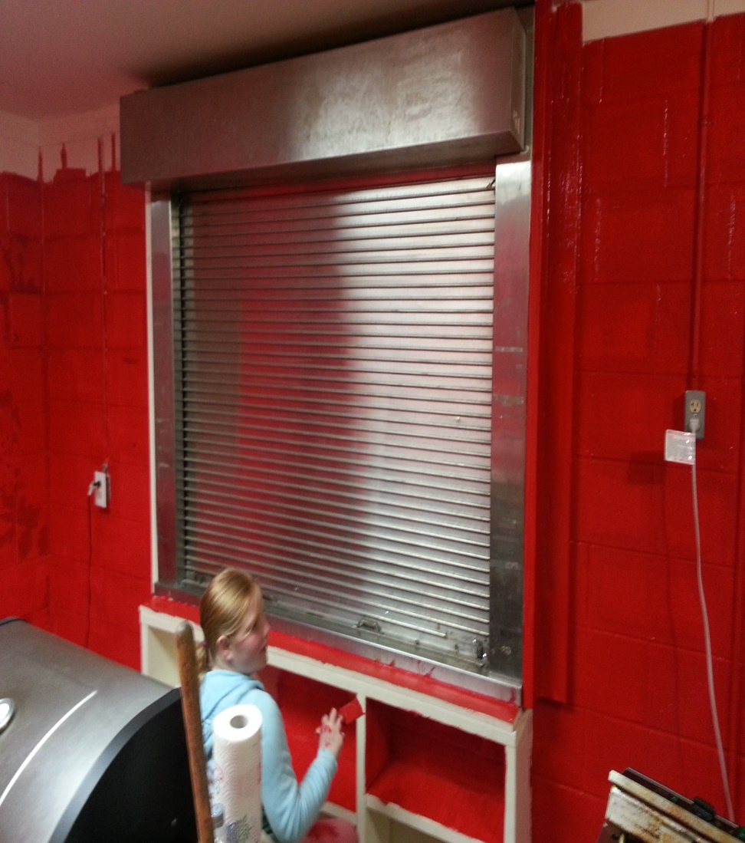
Progress is being made! All creases are filled in so it is time to roll the walls!

Slide 24
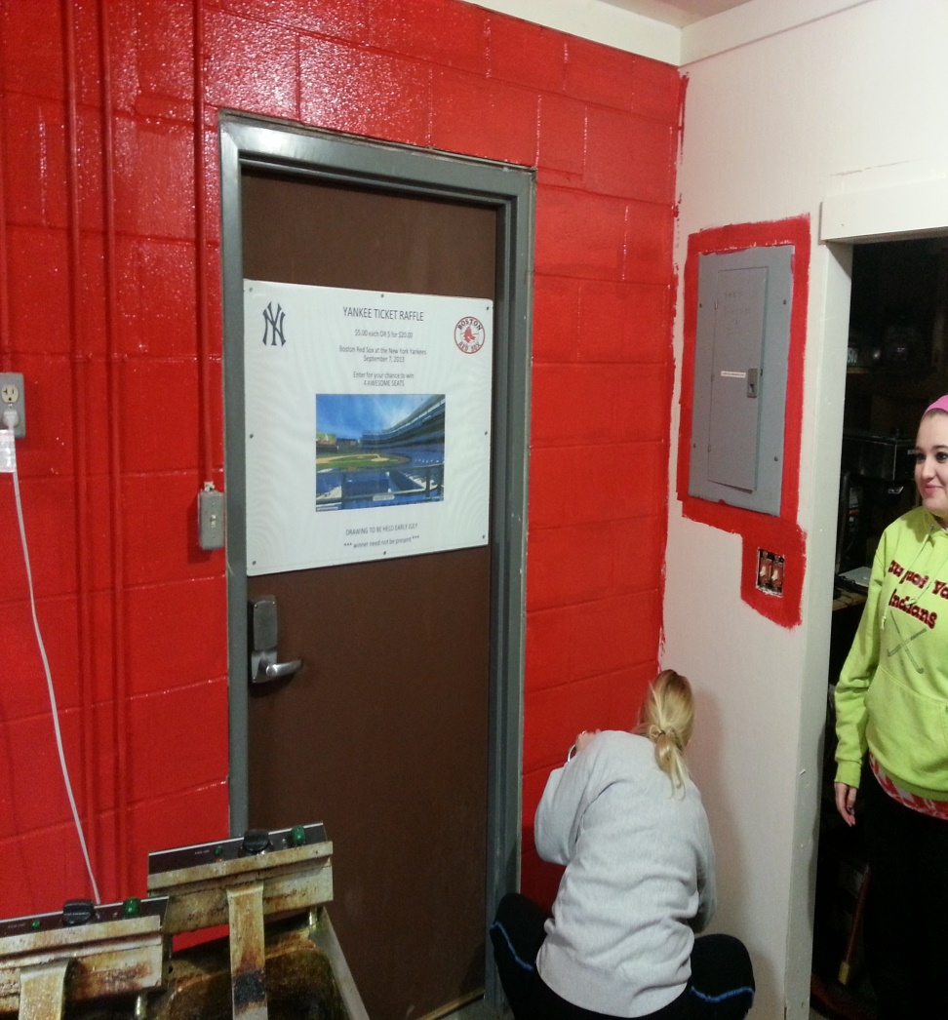
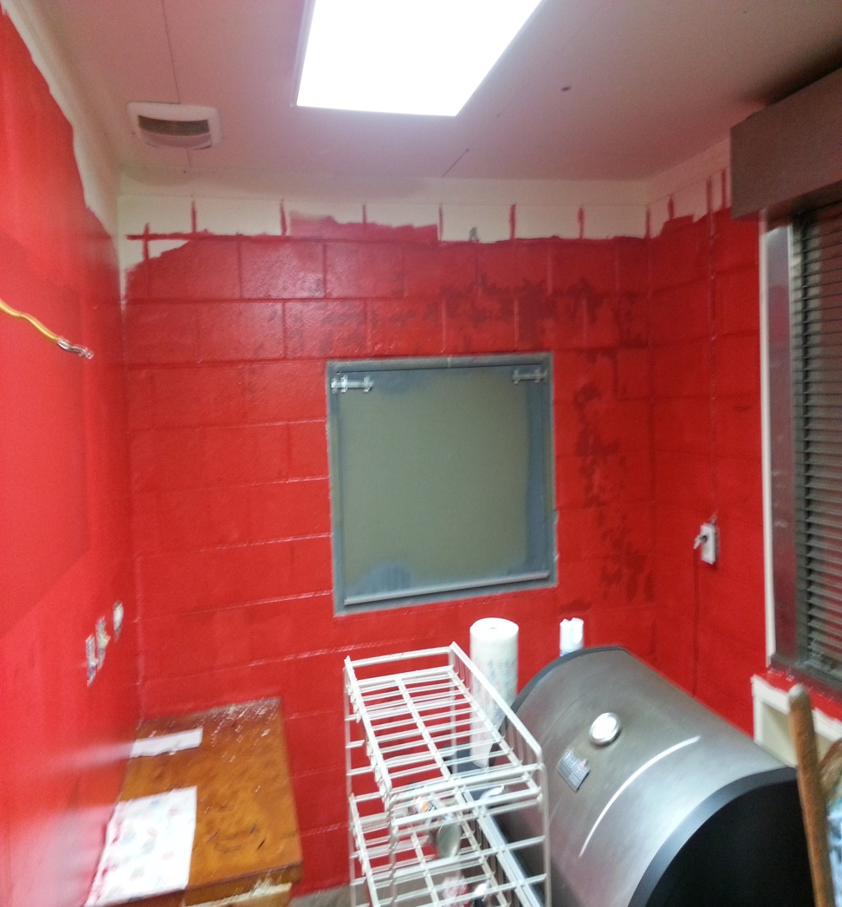
More paint…….

Slide 25
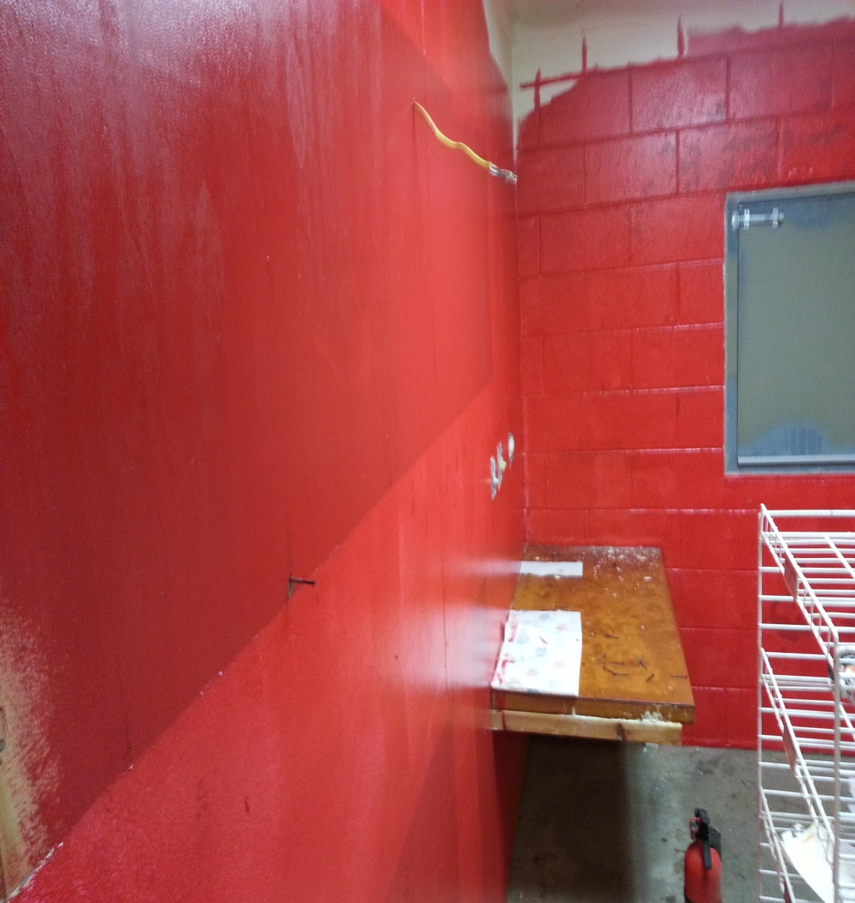
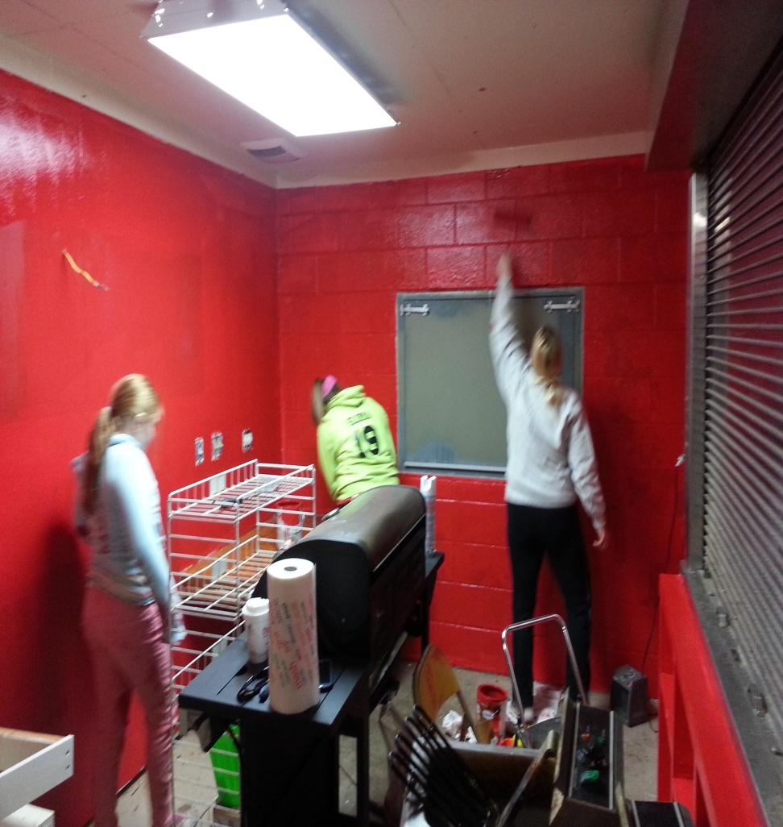
An end in sight!!!! Painting was completed by myself, Missy Clarey, Emilee Clarey and Kellie Sloma

Slide 26
Detailed Schedule cont.
After the extremely cold weather and two feet of snow…
February 17 – 8:00 a.m. Kevin Williams called Wayne Inglis to plow driveway into the field so that we have acess.
10:00 a.m. Kevin Williams and Amanda English stop at field to turn heaters on, then go to Home Depot for sink, screws, caulk, 2x2 board, level.
12:00 p.m. Kevin Williams and Amanda English arrive at field.

Slide 27
Detailed Schedule cont.
Kevin shovels path from truck to garage and to concession stand door.
Missy Clarey comes to help carry cabinets from garage to concession stand. 12:00 – 12:30.
Kevin Williams and Amanda English hang wall cabinets.
Install base cabinets. End 3:00 p.m.
5:30 p.m. Jamie Clarey, Kevin Williams and Amanda English return to field to cut down donated countertop and put in place. End 6:30 p.m.

Slide 28
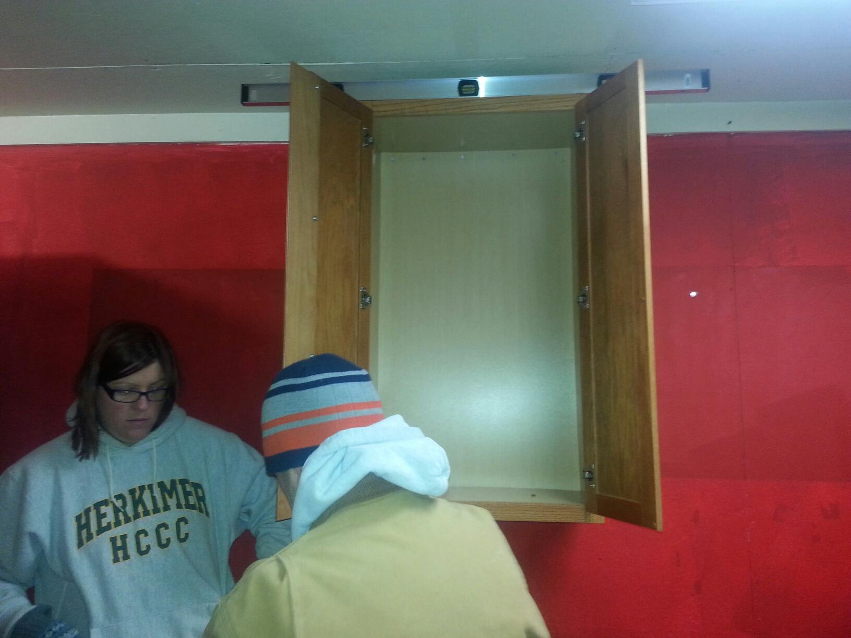
The first cabinet is up!!!!
Cabinets were hung with the help of Kevin Williams, Missy Clarey and myself.

Slide 29
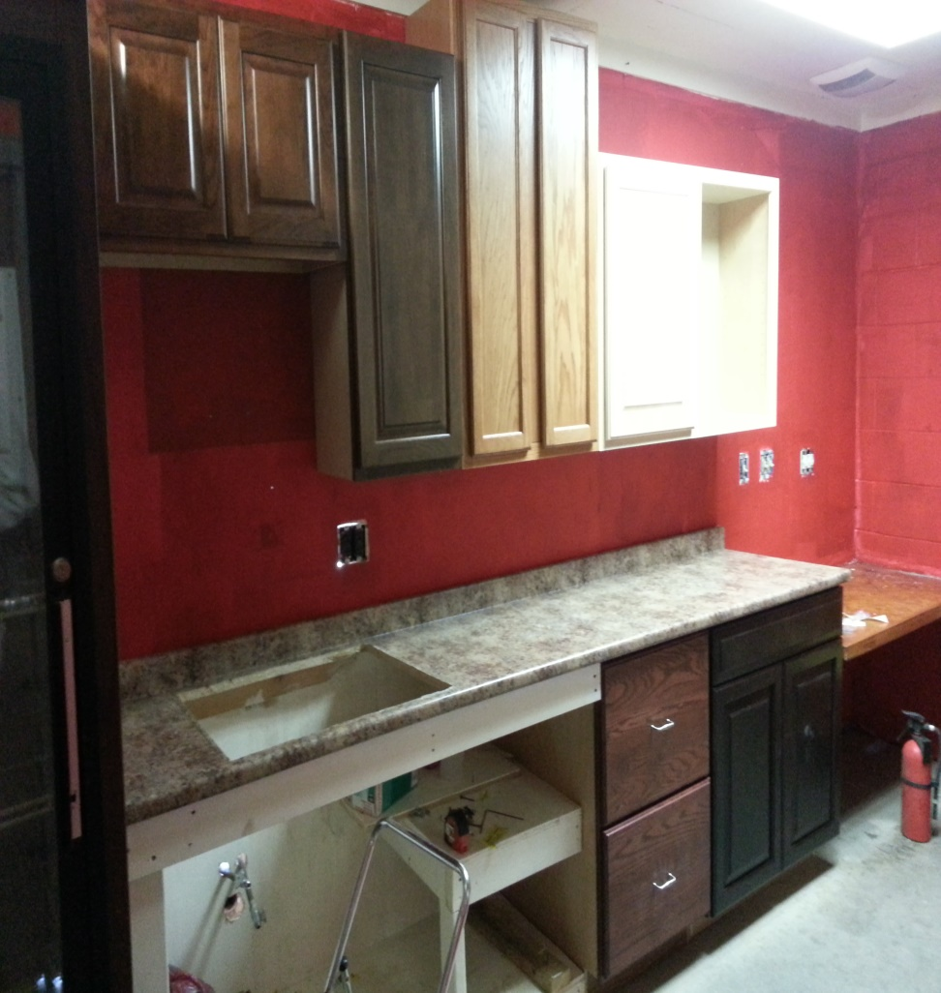
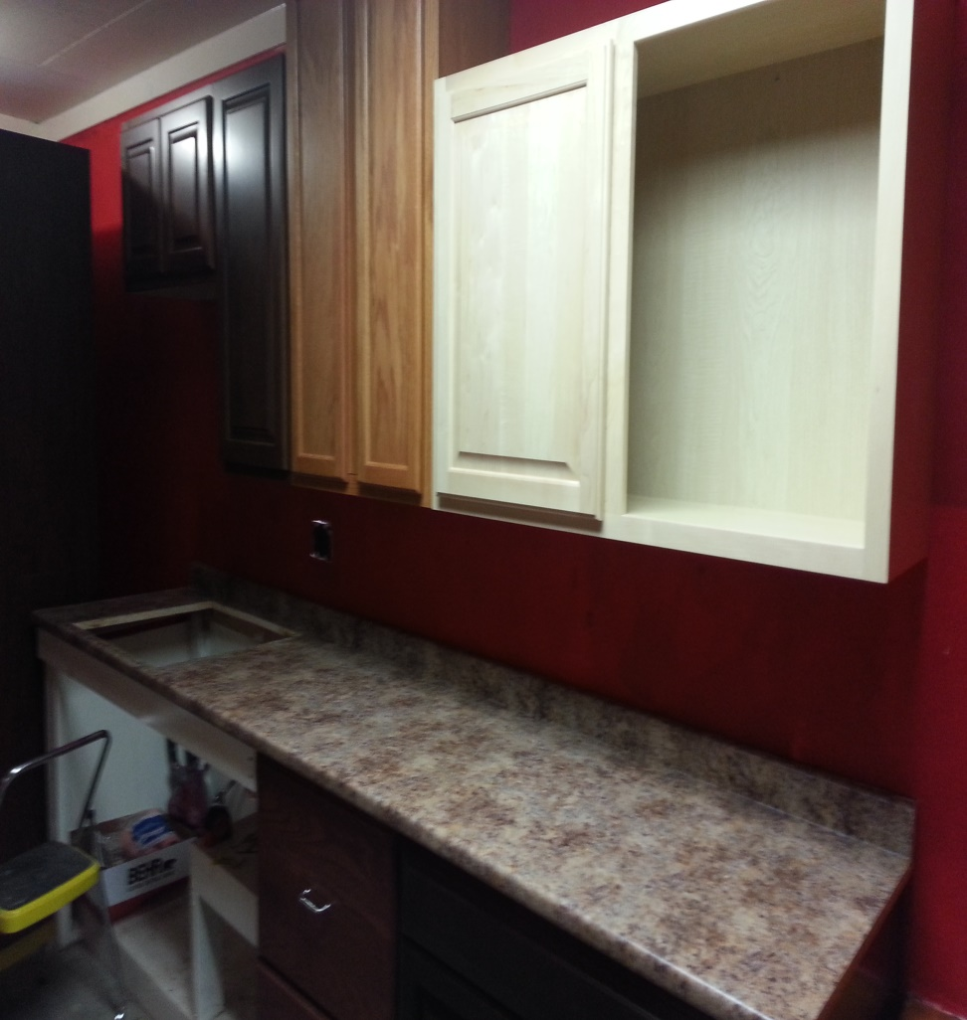
THE CABINETS ARE IN!!!

Slide 30
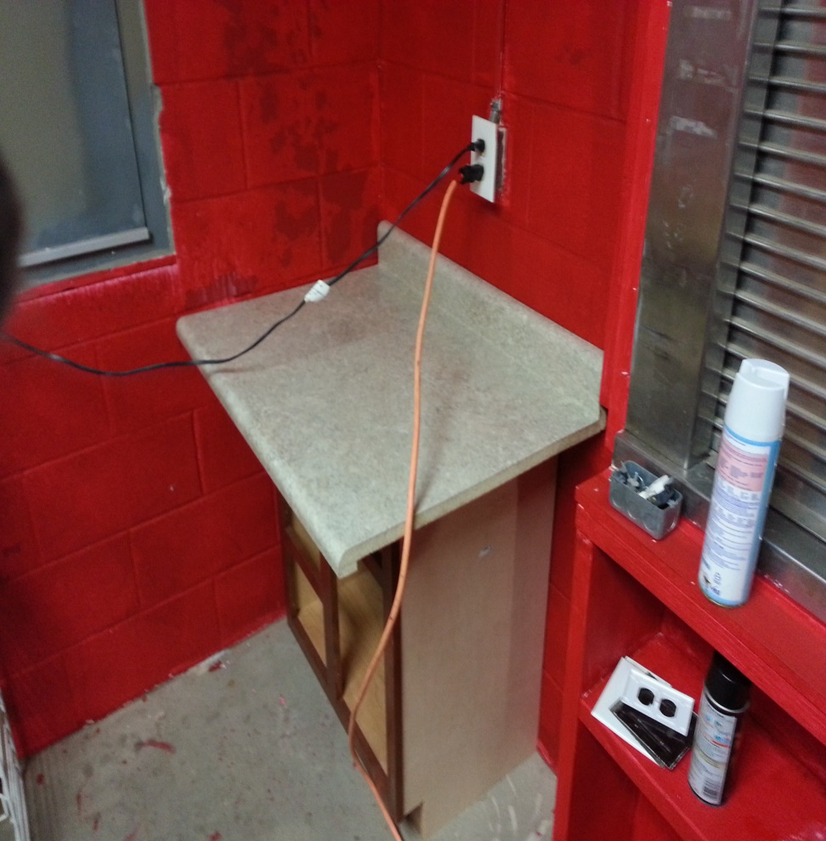
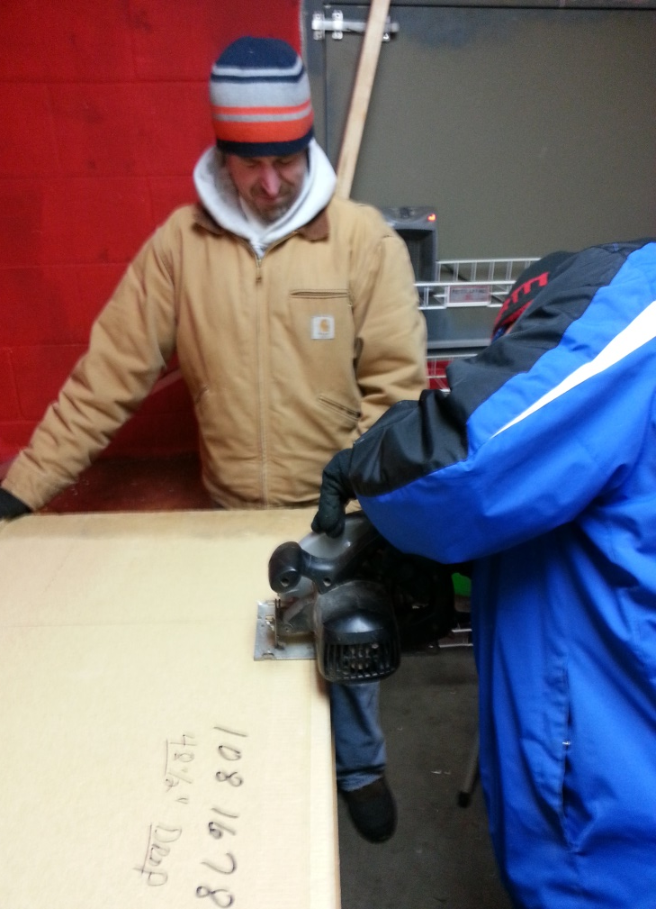
Sawing the new countertop to fit the corner.

Slide 31
Done as I can be for now
Due to the extreme cold weather, my project cannot be completely done until the temperatures rise. It has to be over 35 degrees outside to paint. The concession stand needs another coat of red, and some baseballs painted on the walls. The bathrooms also need to be painted. This is set to be done on March 29th, our first field clean up day.

Slide 32
VOLUNTEERS
Kevin Williams – S.V.Y.A Treasurer and my boyfriend
Missy Clarey – S.V.Y.A Secretary and my sister
Jamie Clarey – S.V.Y.A President and my brother in law
Kevin Sloma – S.V.Y.A Vice President
Kellie Sloma – daughter of Kevin Sloma – looking for community service hours
Emilee Clarey – daughter of Jamie and Missy, and my niece.

Slide 33
Leadership Skills
As the leader of this project, I knew my role and that ultimately I was in charge. I definitely welcome any advice or ideas that my workers give, because after all I am not a carpenter. I took complete responsibility for this project, and worked by myself when I did not have helpers available. I knew that I had a deadline, and that really only meant something to me. The schedule that I originally set, was altered quite a bit due to the weather. As the leader, I worked around these unforeseen issues and implemented a new schedule. I did not want my volunteers to be subject to the bitter cold temperatures.

Slide 34
Leadership Skills cont.
From the beginning stages of the project I delegated some tasks to others, such as calling for the cabinets and the dumpster. I wanted to get others involved from the get go, so that they could feel as if they were a large contributor to the project.
I visualized what it was that I wanted to be done in the concession stand, put it on paper and then went over it with the S.V.Y.A board.

Slide 35
Leadership Characteristics
Vision – thinking of, picturing and implementing my plan
Goal – to complete rehab of the concession stand building within the time frame set by the HP303 class.
Competency – I organized a competent group of volunteers with different skills in all areas needed.
Inspiration – The inspiration for this project was and still is to see the kids faces when the concession stand opens this spring.
Ambition – Taking on a project of this magnitude in the small time frame is an ambitious project. If it wasn’t for the extreme weather I would have finished all that I set forth to do.

Slide 36
Leadership Styles
Even before this project, I have thought of myself as a delegative leader. I do not like to be completely in charge of everything with no help from others. I delegate tasks to my helpers and expect them to keep up their end of the deal and complete the tasks. During this project, I also followed the participative leadership style. I involved my helpers in the decision making process. Missy Clarey helped make the decisions on which cabinets we would take from Fahy Kitchens. Kevin Williams helped analyze and decide the order in which the cabinets should go up. I openly took opinions and advice from all workers. The only time that I think I used the authoritarian style of leadership was on February 17, when it was a balmy 20 degrees outside and I was not taking no for an answer on getting the cabinets hung. My deadline was fast approaching and I needed the main part done. I cannot hang cabinets by myself, so I needed my team there with me.

Slide 37
My plan for the Spring….
The two bathrooms in the concession stand building were on my original plan to complete for this project. As stated before, the weather did not cooperate. However, I still want to go over my plan for them because they will be completed this Spring. I also need to do a couple finishing touches in the concession stand once the weather warms up a bit.

Slide 38
Concession Stand Finishing Touches
Place sink in counter
Attach necessary pipes and faucet (this could not be completed due to possible pipes freezing again, water is turned off)
Complete second coat of paint on walls.
Paint baseballs and other insignia on walls to add character

Slide 39
Bathroom Plans
Install new toilet tanks, replacing old cracked ones
Paint girls bathroom – Red on 2 walls for the Angels; Orange on the other 2 walls for the Tigers. (the 2 girls softball teams in our league)
Paint boys bathroom – Red on one wall for the Reds; Royal Blue on one wall for the Indians; and Navy Blue on a third wall for the Braves.(the 3 Little League teams)
All painted walls will also be detailed with the names of the teams.

Slide 40
Girls bathroom Colors
ANGELS
Tigers

Slide 41
Boys Bathrooms
Indians
Braves
Reds

Slide 42

S.V.Y.A

Slide 43
THANK YOU!!!!!
A HUGE thank you to all of my volunteers/workers. I could not get this done without your help and support.
Kevin Fahy Kitchens has always been a supporter of the youth in my community. This business will have a sign hanging in our Little League field at no cost for many years to come. Also, a sign will hang in the concession stand stating cabinets donated by Kevin Fahy.

