Slide 1
ROADMAP TO
OPENING
We are here to help you navigate the store re-opening.
We’ve put together a comprehensive reentry program to
help ensure the safety and wellbeing of staff and customers at all of our campus store locations. This document will provide stores with the guidelines and necessary changes needed to open your doors. A seven-day lead time is needed to successfully take action within our stores to execute reopening with confidence.
While this will prepare us for the summer sessions,
we will continue to re-evaluate our strategies to provide
more guidance as we approach the Fall term. All stores
are instructed to check with local jurisdictions and
partner with their campuses and Regional Managers to maintain compliance and support specific requests.

Slide 2
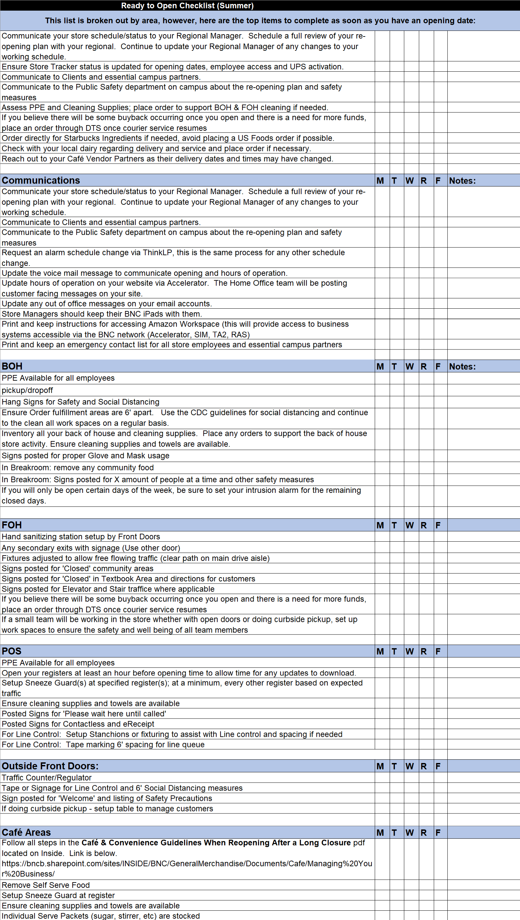
Reopening Store Checklist
REENTRY STRATEGY | 02

Slide 3
  Off Limit Areas
• Info Stations
• Seating / Lounge Areas
• Secondary Entrances
• Textbook Department
• Unpackaged, Self-serve Foods/Coffee Area
RELOCATE
Textbook
Distribution
• Counter service only
• Set up 6’ marker
in queue line
FIXTURES
• One direction
shopping down aisle
REMOVE
Self-serve
Foods/Coffee
• Prepackaged
foods only
CLOSE
TO PUBLIC
Lounge Areas
To Customers
STOP
Non-personnel
Entry through
Back door
CLOSE
TO PUBLIC
Back of
House
• Employees practice
social distancing
CLOSE
TO PUBLIC
Textbook
Area
• Employees practice
social distancing
CLOSE
TO PUBLIC
Secondary
Entrance
• Place do not enter
signage on door
• Do not block
• Emergency egress
CLOSE
Every Other
Cash Station
• Leave a space between
cash stations if possible
REENTRY STRATEGY | 04

Slide 4
  Keys to a Successful
  Reopening
• Promote the health and wellness of
your employees and customers
• Ensure your buildings are safe,
resilient, and ready
• Create and monitor
effective guidelines
Taped
drop zone
• Tape off a 4’x 4’ square
inside the back of house
for delivery drop off
Textbook
pick up
sign
Welcome
back and
safety
stanchion
sign
Hand
sanitizer
Window
sign
• Promoting occupancy
limits hours of
operations
timed shopping
Breakroom
social
distancing
sign
Tape arrows
• Tape off arrows between
gondolas to create
one-directional shopping
• Promoting social distancing
Tape arrows
• Tape off arrows between
gondolas to create
one-directional shopping
• Promoting social distancing
Queue
line tape
• Max occupancy
guidelines will
differ per state
• Cut tape into
1’ wide strips
• Space strips at
6’ intervals
Store traffic
greeter
Curbside
pick up
sandwich
board
Back of
House
• Employees practice
social distancing
• Workstations 6’ apart
Hand
sanitizer
Textbook
area
• Closed to public
• Employees practice
social distancing
Queue
line tape
• Set up 6’ marker
in queue line
Queue
fixtures
• Use fixtures to assist
with line control/signage
POS at every
other station
REENTRY STRATEGY | 05

Slide 5

Cashwrap
Strategy
We understand all stores are not the same.
Please review these diagrams on how best to
Reorganize your store to promote health and
Wellness among customers and employees.
Feel free to make revisions based on the
unique layout of your particular store. Changes
must be in compliance with the general guidelines
in this document.
• Add sneeze guards
• Close every other
register if possible
• Maintain 6’ social
distancing for all
customers and
employees
• Set signage and
tape out floor
Sneeze
guard
Sneeze
guard
Open
POS station
• Set up 6’ marker
in queue line
Open
POS station
• Set up 6’ marker
in queue line
Closed
register
CO-5 Cashwrap Diagram
REENTRY STRATEGY | 06

Slide 6
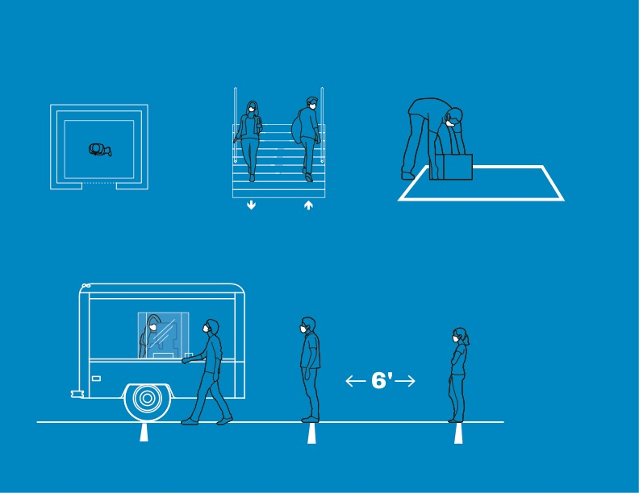
Additional
Recommendations
ELEVATOR
Limit elevator capacity to
1 person or family group
STAIRS
Tape arrows to top and
bottom of stair to direct
single lane traffic
DELIVERY DROP ZONE
Deliveries to be placed on taped square
directly inside BOH doors
OPPORTUNITY FOR POPUP SHOP
Repurposed game day trailer for popup shop
REENTRY STRATEGY | 08

Slide 7
Reopening Signs
Outside of Store
Front Entrance
Curbside Pickup
8½” x 11”
Line to Enter
8½” x 11”
Closed Entrance
8½” x 11”
Guidelines
8½” x 11”
Inside of Store
Textbook Counter Service
8½” x 11”
Closed Section
8½” x 11”
Café Closed
8½” x 11”
REENTRY STRATEGY | 09

Slide 8
Reopening Signs
POS/Queue Line
Line Spacing
8½” x 11”
Contactless Payment &
e-Receipts
8½” x 11”
Contactless Payment &
e-Receipts
8½” x 11”
Elevators and Escalators
Social Distancing
Elevator
8½” x 11”
Escalator
8½” x 11”
Social Distancing
8½” x 11”
Café Social Distancing
8½” x 11”
REENTRY STRATEGY | 10

Slide 9
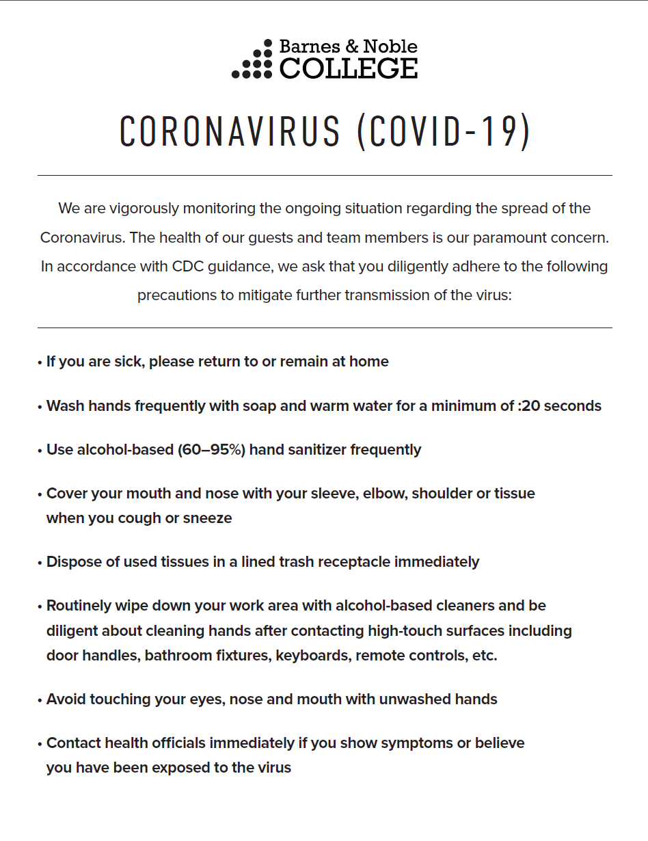
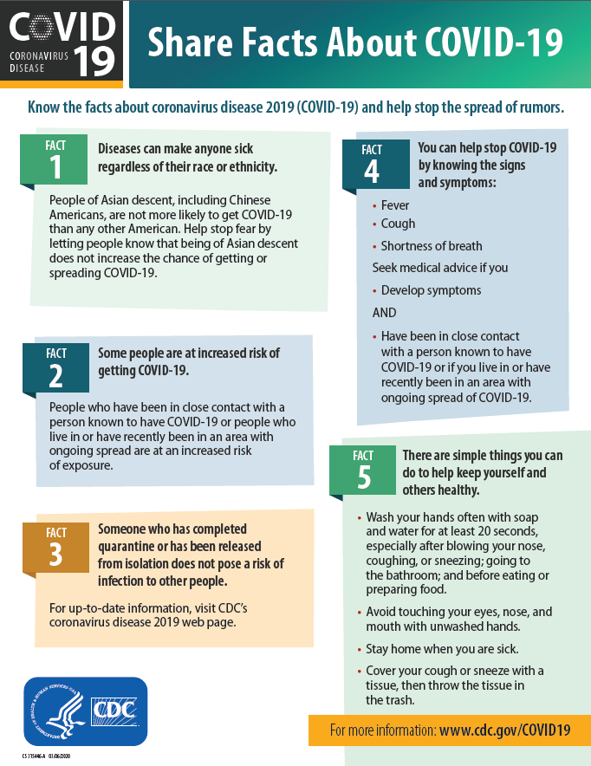
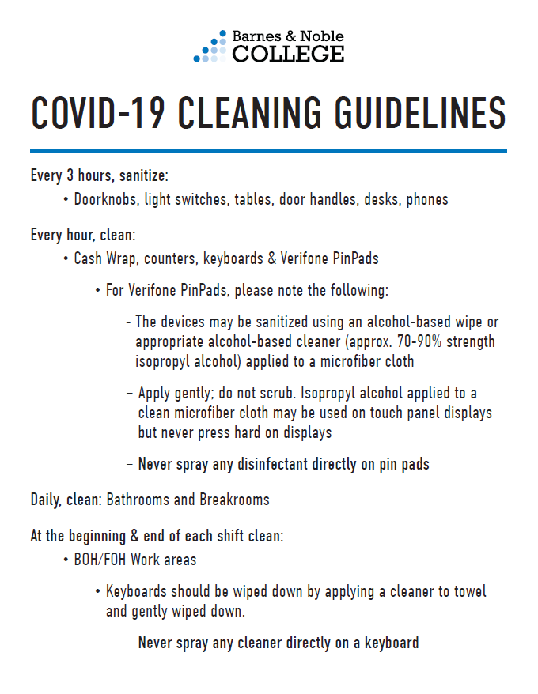
Reopening Signs
Back of House
World Health
Organization
8½” x 11”
COVID-19 Operational​
Guidelines
8½” x 11”
COVID-19 Backroom
8½” x 11”
COVID-19 Info Sheet
8½” x 11”
Cleaning Guidelines
8½” x 11”
REENTRY STRATEGY | 11

Slide 10
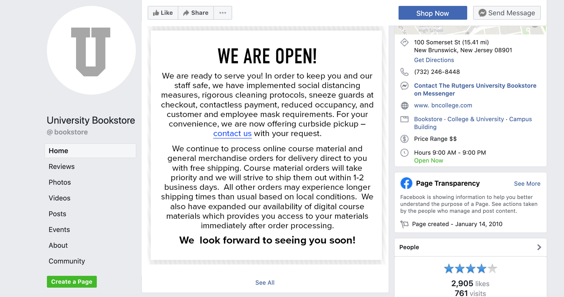
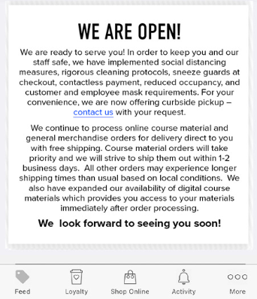
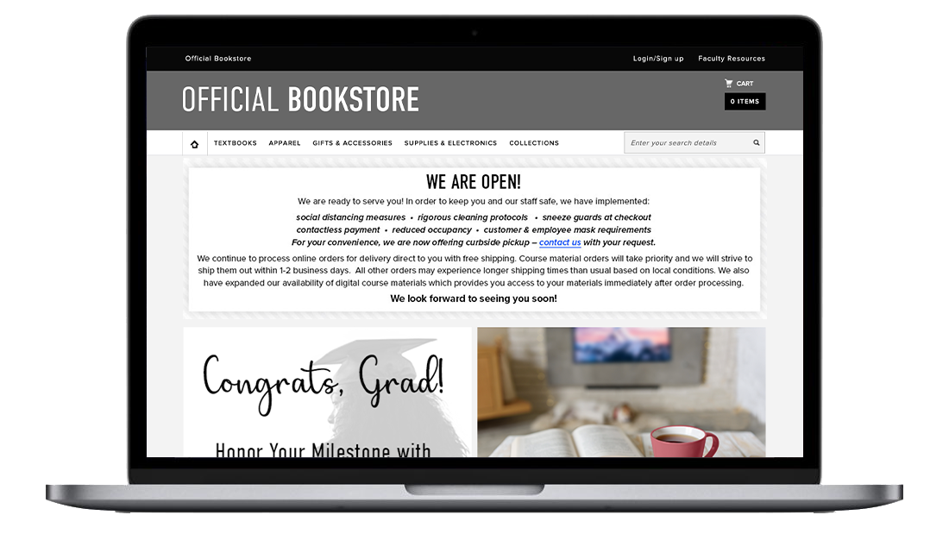
Reopening Strategy
Digital Messaging
REENTRY STRATEGY | 12

Slide 11
PPE Guidelines
Disposable Masks
• Recommend a disposable mask per day per
employee unless it becomes soiled or its
properties have become compromised
• Employees can wear their own and are
encouraged to do so. Offensive masks should
not be used
Cloth Masks
We’re going to provide 2 cloth masks per person. Each employee will be responsible for cleaning their mask and bringing one of the masks to work for their shift.
• Employees can wear their own and are
encouraged to do so. Offensive masks should
not be used
Gloves
• Supplies will be available if an employee chooses
to wear gloves, however, it is not mandatory
• All booksellers should still be following regular
cleanliness guidelines throughout the day
regardless of the task
• Change gloves often, especially if you
sneeze or cough on gloves
• Do not reuse gloves. Discard all gloves
once they have been removed
• Wash hands before putting gloves on
and after removing gloves
• Remove gloves after touching your face
Hand Sanitizer
• Will be available throughout the store for
both customers and employees
Cleaning Supplies
• On SAM, there is a catalog labeled
“Cleaning Supplies & PPE.” In this catalog,
you will find various items related to COVID-19
All employees are encouraged
to follow the World Health
organization which recommends
the following practices to reduce
exposure and transmission of a
range of illnesses
1. Wash hands regularly with soap or
alcohol-based hand sanitizer
2. When coughing and sneezing, cover
mouth and nose with a tissue
3. Avoid touching eyes, nose, or mouth
with unwashed hands
4. Avoid close contact with infected individuals
REENTRY STRATEGY | 14

Slide 12
Cleaning Schedule
Clean and disinfect frequently touched surfaces routinely through the day
• These areas include but are not limited to counters,
cash wrap, doorknobs, light switches, tables, door handles,
desks, phones, keyboards and PinPads.
• Doorknobs, light switches, tables, door handles, desks,
phones, etc. should be sanitized every 3 hours.
• Cash wrap and counters, including Verifone PinPads,
should be cleaned hourly
Cleaning Verifone PinPads
The devices may be sanitized using an alcohol-based wipe or appropriate alcohol-based cleaner (approx. 70-90% strength isopropyl alcohol) applied to a microfiber cloth.
• Apply gently; do not scrub. Isopropyl alcohol applied to a
clean microfiber cloth may be used on touch panel displays
but never press hard on displays.
• Never spray disinfectant directly on PinPads.
Bathrooms and Breakrooms
• Bathrooms and Breakrooms should be cleaned daily.
Back of House/Front of House
• BOH/FOH areas should be cleaned at the beginning and
end of each shift.
• Keyboard should be wiped down by applying a cleaner to
towel and gently wiping down.
• Never spray any cleaner directly on a keyboard.
REENTRY STRATEGY | 14

Slide 13
All Employees Must Wear Face Coverings
We mandate that our employees wear face coverings in our stores and outside the stores for curbside pickup. Any employee who refuses to wear a face covering will be sent home. Employee’s may use their own face coverings (if they are appropriate) or those we supply.
Customer Face Coverings
Our policy regarding whether a customer must wear a mask will be dictated by state/local guidance and school policy.
Where not required, signage will read “We request that customers wear masks to help keep our employees safe.”
If legally required, any customer who is not wearing a mask should be stopped from entering the store. Once in the store, if the mask is removed, a member of management should politely approach the customer, reiterate the signed policy and offer them the opportunity to put the mask back on or to leave the store. If a customer is combative or refuses to comply, contact campus security/police for assistance.
REENTRY STRATEGY | 16

Slide 14
Quarantine/Isolation
Scenarios
1. Employee is Symptomatic
• Employee should stay at home until symptoms resolve
• No fever present for a period of 72 hours without use of fever reducing
medication.
2. Someone in the employee’s house is
Symptomatic
• Employee should Immediately engage the Benefits department at
benefits@bned.com for assessment.
• Review the CDC Resource page for Caregivers.
3. Employee was exposed to someone
(outside of their household) who is
Symptomatic
• Employee should engage with the Benefits department and monitor
symptoms.
4. Someone in the employee’s house was
exposed to a third party who is now
Symptomatic
• Employee can continue to work but is expected to self-monitor for any
symptoms of illness (fever, fatigue, cough, difficulty breathing).
• Employee should report those symptoms immediately if they occur.
• Employee with symptoms falls into scenario 1 above.
5. Customer or Employee at work is visibly ill
• Two members of management should observe the individual and
document their observations.
• Most senior member of management should approach the employee
or customer, detail what they have observed, ask that the customer or
employee leave the store until their symptoms are gone.
• If a customer refuses, store may contact the campus security/police for
assistance.
• If employee, they must punch out and leave the store.
• Immediately disinfect all surrounding surfaces and keep others out of
the areas in which the customer or employee had been until all
surfaces have been disinfected.
Symptomatic
Employee Isolation
Protocol
To ensure the safety of our employees and customers, we ask all employees to follow the recommendations for quarantine or isolation in the event they are symptomatic of COVID-19.
We are asking employees to stay home if sick, monitoring themselves for symptoms and where appropriate, quarantine.
REENTRY STRATEGY | 17

Slide 15
At Risk Employees
Reasonable Accommodations
Upon request by an employee directly to the Benefits Department, the company will engage in the interactive process to explore whether a viable accommodation is available for any employee who has a disability. The CDC has identified those at higher risk from COVID-19 to include:
  Employees aged 65 or older;
  Employees with chronic lung disease or moderate to severe asthma;
  Employees who have serious heart conditions;
  Employees who are immunocompromised;
  Employees with severe obesity (body mass index [BMI] of 40 or higher);
  Employees with diabetes;
  Employees with chronic kidney disease undergoing dialysis;
  Employees with liver disease; and
  Employees who are pregnant.
This protocol will remain in effect until the HR Team has determined, based on guidance from the US health authorities or federal and local authorities, that it is safe to terminate. The HR Team will advise our stores once this determination has been made.
Employees outside of the scenarios listed above who are unable to return to work should contact the Benefits Department directly to determine if an accommodation is a viable solution or if other options are necessary.
Conversations regarding Accommodations should be made with the Benefits Department only.
REENTRY STRATEGY | 18

Slide 16
Screening Employees
To ensure the safety of our employees and customers and follow state, local rule or school policy it is determined that employee health screening must occur before an employee is permitted to work.
Check Your Temperature
Before leaving home for work, you must check your temperature using a thermometer to verify your temperature is under 100 degrees.
• If your temperature is 100 degrees or more, you
should remain at home and contact your Store
Manager.
Evaluate for Symptoms of COVID-19
• Before leaving home for work, you must evaluate
your health for symptoms of COVID-19.
• If you are experiencing coughing, difficult breathing,
fatigue, or fever you should remain at home and
contact your Store Manager.
To help prevent the spread of COVID-19 and reduce the potential risk of exposure to our employees and customers; temperature and health self-screening is in place at all stores until the Global Prevention Team has determined, based on guidance from the global and local health authorities and the applicable governmental requirements that it is safe to discontinue.
Your participation is important to help us take precautionary measures to protect you and everyone in the store! Thank you!
REENTRY STRATEGY | 19

Slide 17
Suspected Symptoms or Positive COVID-19 Testing
To ensure the safety of our employees and customers, we ask all employees to follow the recommendations for quarantine or isolation in the event they are symptomatic of COVID-19.
If an employee suspects they have symptoms of COVID-19:
Symptomatic employee will remain anonymous.
All surfaces touched by the employee will be thoroughly cleaned and disinfected.
If an employee tests positive for COVID-19…
Employee is to contact the Benefits Department at benefits@bned.com to discuss steps and return to work clearance that is required prior to return to the company premises.
All store employees will be notified by Store Management under the direction of the Benefits Department.
Name of ill employee will remain anonymous.
Employees coming into direct exposure (less than 3 feet) will be directed to follow self-quarantine protocols and must coordinate with the Benefits Department at benefits@bned.com to return to work.
Conversations regarding Positive COVID-19 results should be made with the Benefits Department only.
REENTRY STRATEGY | 21

